Slide 1
Do All Users Benefit Equally from
Web Performance Optimizations?
Arnaud Becart – @arnaud_be
ip-label
Notes:
Slide de titre de la présentation

Slide 2

Real-User MOnitoring
≠
Synthetic testing
Previously, at Velocity Berlin…
Notes:
Last year when I was at the Velocity conference in Berlin, I introduced
Over the past year, it has been confirmed time and again that when it comes to evaluating performance for end-users…

Slide 3

Synthetic Testing
Notes:
… yes we are not in Berlin any more.
So why is synthetic testing not enough?

Slide 4
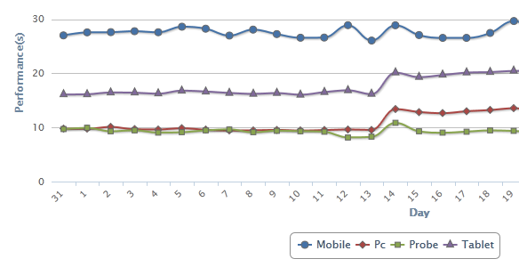
Proof by example
Real Users
Mobile + 0 s
Tablet + 4 s
PC + 4 s
Synthetic Tests
+ 0 s
Synthetic Tests don’t see everything
Notes:
Well typically here is a good example from a real web site, where you see that synthetic tests do not change a bit while real-users’ PCs or tablets register a jump of 4 seconds.
So No: synthetic tests don’t see everything

Slide 5
Some Differences between synthetic tests & RUM
Multiple tabs
Browser
OS version
Fixed location
Nomadic usage
Antivirus
Device
Fixed
last mile
Browser add-ons
Provider
OS
Browser version
Network
access
Browser cache
CPU
Bandwidth
Mobile
last mile
Memory
1. Similar or different between synthetic & real-user testing
2. No synthetic testing
3. Variable, depending on users’ behaviour
Notes:
Why these differences in results? You have a lot of factors obviously.
Some can be similar or different (a mobile device or an exotic location)
Some are even not considered by synthetic tests. For example, browser plug-ins or people on-the-move, using their phone in a moving train
And some factors are even more variable depending on what the user is doing while browsing, or how old or powerful the device he or she is using is.

Slide 6
Back to the Title
CSS at the top
Fewer HTTP requests
Expires header
Accelerate rendering
Do All Users Benefit Equally from
Web Performance Optimizations?
Gzip
Reduce size
Avoid redirects
CDN
Defer
third-party content
…
(thanks Steve)
JS at the bottom
Notes:
When all is said and done, once you have optimized your website manually or automatically, how can you be sure that each specific rule will be efficient?

Slide 7

Real Life Example e-retail web site
Notes:
So let’s take a real case on an e-retail website, which has enough visits to make a proper analysis.

Slide 8
Methodology
synthetic_monitoring()
optimization ()
while not improved(synthetic_monitoring()):
optimization()
//responsetime is better!
real_user_monitoring()
Notes:
First a little basic methodology:
You are carrying out web optimization.
As long as synthetic trends have not improved, there’s no point in looking at real users.
And you can loop forever if you want.

Slide 9
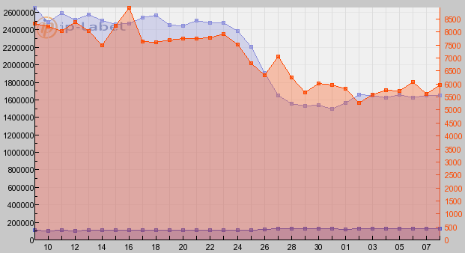
synthetic trend
1st Step: Confirm trend with synthetic testing
Page Load Time
Page Size
2.5 Mb
1.6 Mb
7.4 s
5.7 s
Fewer requests
& Compression
35%
Reduction in page size
30% quicker start rendering
23% quicker page load time
Notes:
The first step, then, is to confirm the optimization with synthetic tests.
Here a simple page size reduction of 35% which resulted in a 30% improvement in start rendering time, and 23% better page load time.

Slide 10
What about real users ?
2nd Step: Align Real Users & Synthetic tests
  URL, Country, ISP, Metric (onload event), Period (2 months)
3rd Step: Analyze 20M real-user measurements
Page load time: 9.2 s → 8.2 s
Real Users’ Performance gain: 11%
Notes:
The next step I took was to check what happens for real users: did they also experience a 23% quicker response time?
To compare, I had to align real users with the synthetic tests: same page, same country, same ISP (I excluded any major location impact).
Same period, of course, and just as importantly, the same metric (onload event).
It turns out we are far from the 23% benefit identified by synthetic results. The savings in time amounted to only 11% (in other words, 1 second) for every real user.

Slide 11












Back to the title again
Do All Users Benefit Equally from Web Performance Optimizations?
Notes:
Which brings me back once again to the title of my talk: does everyone benefit from a gain in real performance?
Will IE users buy 11% more than Firefox users?
Will the biggest, the thinnest, and the lightest phone users visit more pages?
Will quad-core desktop users download faster than a 20-year-old PC running Windows 95?

Slide 12
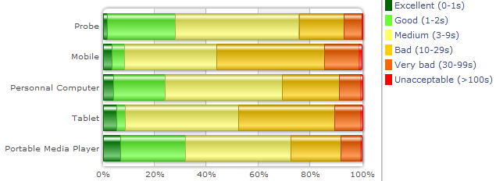

User satisfaction
% of users loading the page in less than 9 seconds
  Mobile: 43% → 55%
  Tablet: 52% → 60%
+12
+8
Notes:
A first analysis of user satisfaction was made. A user was considered satisfied if he or she could load the page in under 9 s.
Optimization made performance satisfactory for 12% more mobile users and 8% more tablet users.

Slide 13
The Device effect
Response time gain (%) per device
12.1 → 11.3 s
7.4 → 5.7 s
9.1 → 8.1 s
21.7 → 16.4 s
Smartphones = High Benefit
Tablets = Small Benefit
Notes:
Analyzing the average gain in response time, shows clearly that smartphones did benefit greatly from the size reduction (4s less on average), but surprisingly not tablet users (for whom only 1 second less was obtained).
Could this be explained by the fact that all tablet users are Wi-Fi users, while smartphone users are cellular users?

Slide 14
The Network effect
Response time gain (%) per type of Network connection
Slow bandwidth + fewer bytes to load = High Benefit
Notes:
This hypothesis appears to be confirmed when we redistribute devices according to type of network.
This is actually quite mathematical: slower bandwidth + fewer bytes to load = higher benefit

Slide 15
The ‘CPU’ effect
Response time gain (%) per device capacity*
Dual Core 2.2 GHz 4G RAM
5.5 → 5.3 s
7.5 → 7 s
8.5 → 8 s
10 → 8.5 s
14.5 → 12 s
20s → 17 s
iPhone 5
iPhone 4
iPad 1
*Not just CPU: processing capacity & available memory
Devices with Very Good or Very Bad Performance (old?)
benefit less from size optimization
Notes:
Not all devices are equal in terms of capacity (of CPU, memory, cache and so on).
So even if now some mobile devices have become more powerful than some desktops we see here we can have major differences between an old and a new device.
Good ones (usually meaning new ones) show a quite limited gain: they are obviously already quick, so the impact on the user is fairly limited.
Slow ones (meaning old ones) on the contrary clearly benefit to a greater extent from that optimization.
Unfortunately for those still running what I would call an ‘unusable’ workstation, the benefit is less. A poorly performing device remains a poorly performing device -- improving your content doesn’t make an iPhone 3 more powerful than an iPhone 5.

Slide 16
The Browser Effect
Response time gain (%) per browser on fixed devices
8.5 → 8.6 s
9.9 → 9.3 s
8.3→ 7.5 s
9 → 7.6 s
No improvement for Safari
Higher benefit for IE
Notes:
Furthermore, not all users have the same browser.
Again, not all browsers are equal: we can even see here that the page load time on Safari did not improve at all.
The results also show that IE benefits most from the web site optimization with a 16% gain, making it as quick as Firefox for that page.
To understand what is behind such outstanding results for IE, it’s important to combine these results with the CPU effect, as we know that browsers have different behaviours depending on the capacity of a device, such as the cache memory size.

Slide 17
The Browser Effect
Response time gain (%) per browser & processing (PC)
Firefox: 6 → 5.3 s
Safari: 7.8 → 8.4 s
Safari: 8.3 → 8.4 s
Chrome: 22.8→ 23.3 s
Are Firefox users geeks?
Is Safari not made for new devices?
Is Chrome not made for very old devices?
Notes:
Our findings from combining browsers & device capacity are that:
only Geeks are using Firefox and have a quad-core processor for their desktops
Firefox yields (pronounced like ‘shields’) good benefits for these devices by accelerating even an initially very fast page
Safari performs well on old devices but not really on new ones
Chrome does not do very well with old configurations, which makes me think that automatic updates might sometimes not be such a good idea for some obsolete devices.

Slide 18

conclusion
Do All Users Benefit Equally from Web Performance Optimizations?

Slide 19
conclusion
Do All Users Benefit Equally from Web Performance Optimizations ?
Old PC
+18%
IE +18%
Synthetic Tests
+23%
Chrome +8%
PC
+10.6%
New PC
+4%
Smartphone
3G Network
+30%
Smartphone
+25%
Real Users
+11%
Tablet
3G Network
+18%
Tablet
+7%

Slide 20
Don’t trust only Synthetic Tests to justify web optimizations
  Not all devices are equal – especially with the network factor
  Not all browsers are equal – especially with “CPU”/”Old device” factor
Don’t be too quick to draw conclusions about the actual effectiveness of optimizations for your real users

Slide 21
Thank you!
www.ip-label.com
Arnaud Becart
@arnaud_be

